Slide 1
How to add Pictures to Windows Movie Maker

Slide 2
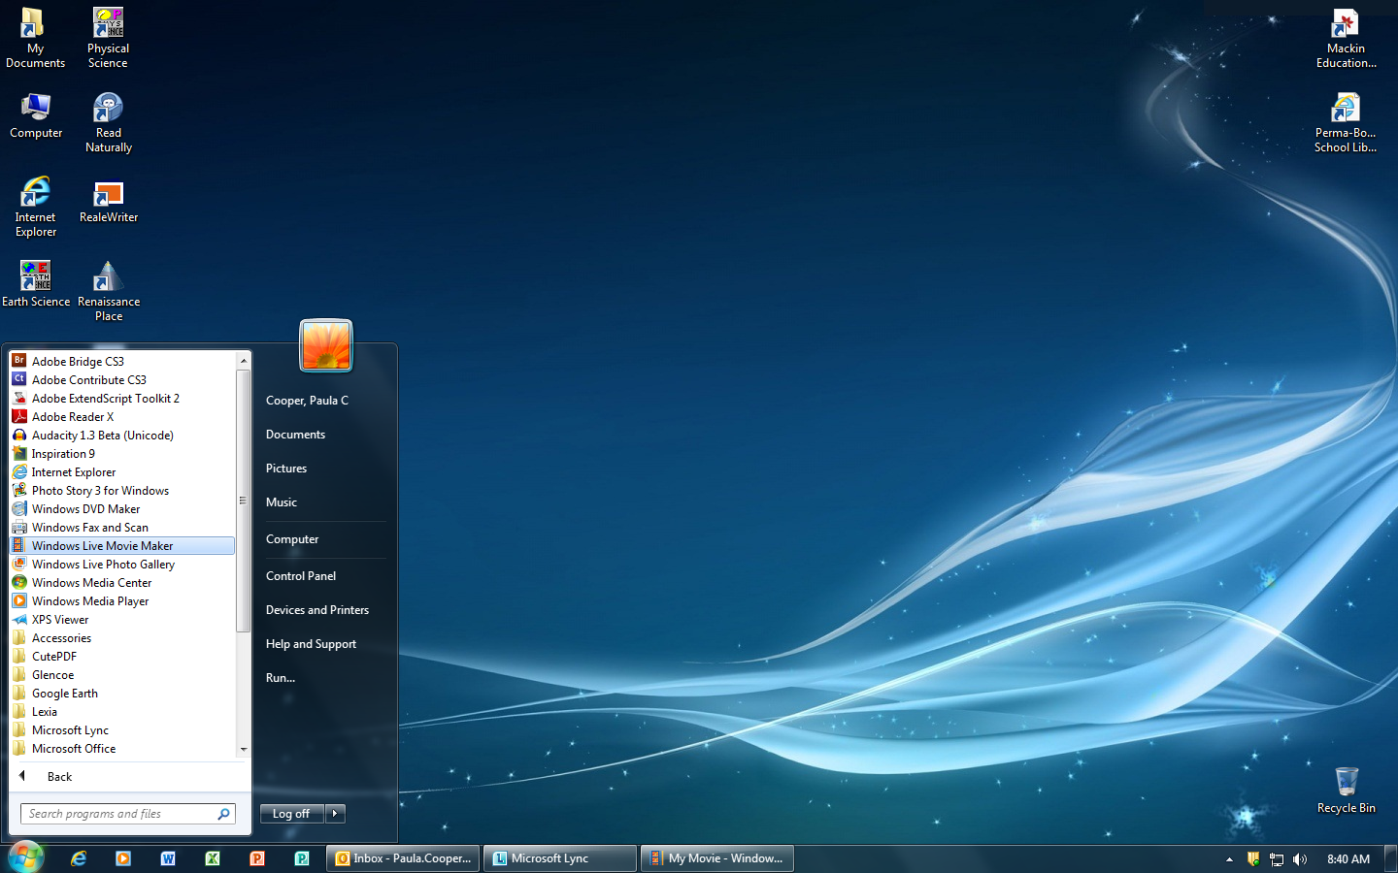
You will be using Windows Live Movie Maker to create your presentation.
Find Windows Live Movie Maker in the Program List
Click on it

Slide 3
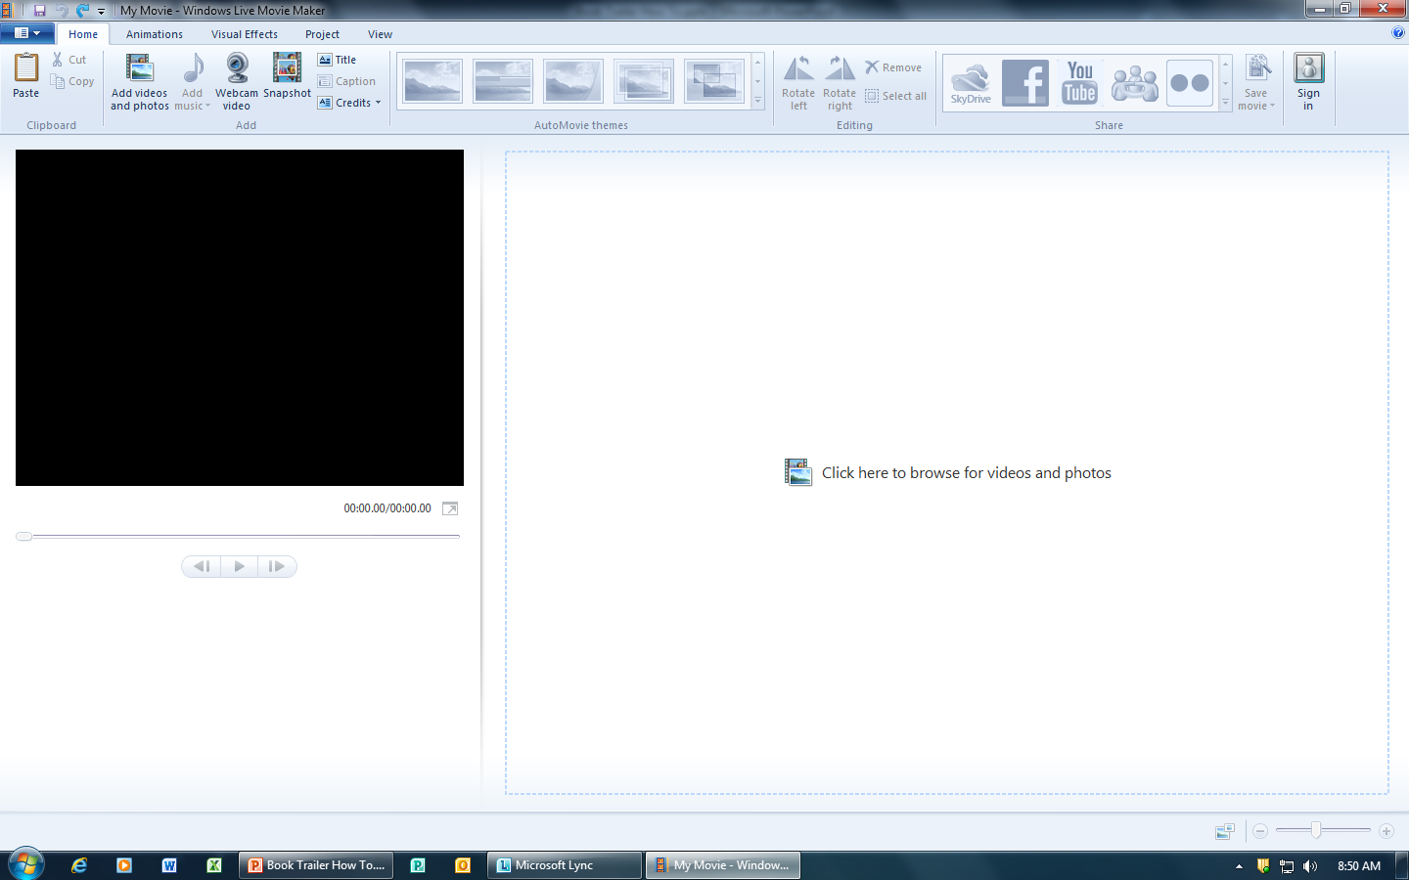
You should now see this….
Click to add your pictures

Slide 4
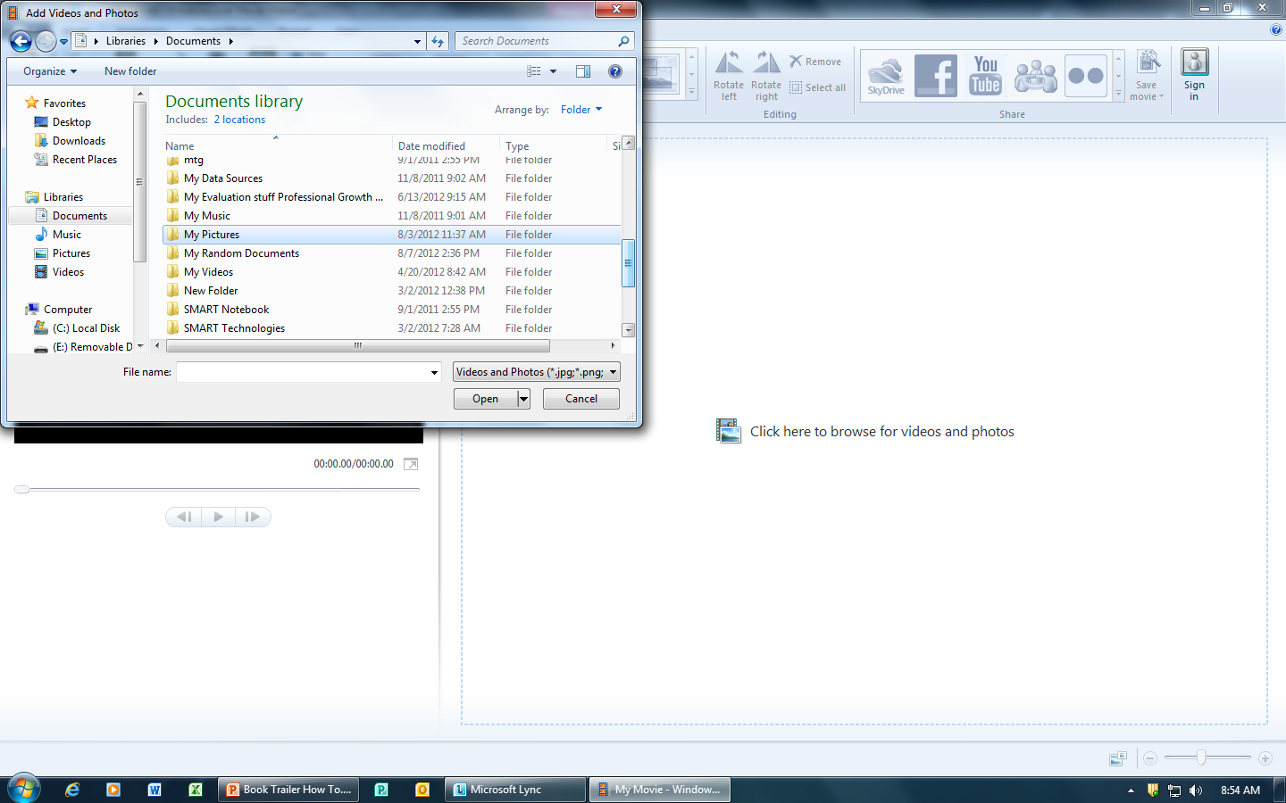
Find the “My Pictures” folder on your H:drive. Click open

Slide 5
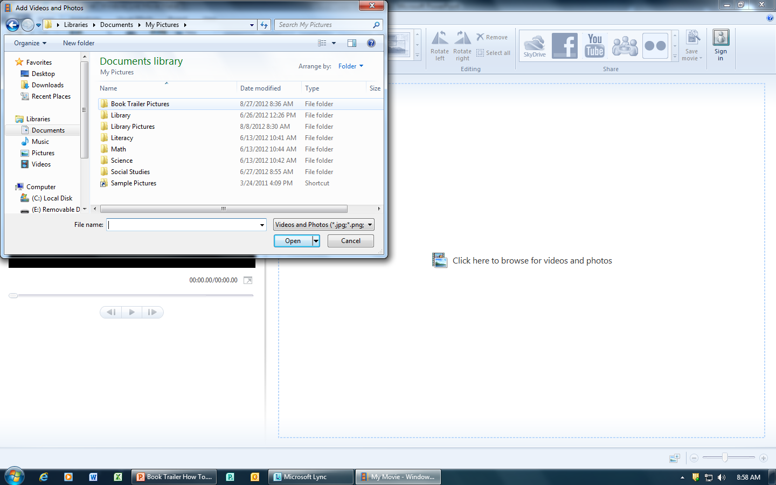
Find your “Presentation” folder (Or whatever folder you have saved pictures in) Click Open

Slide 6
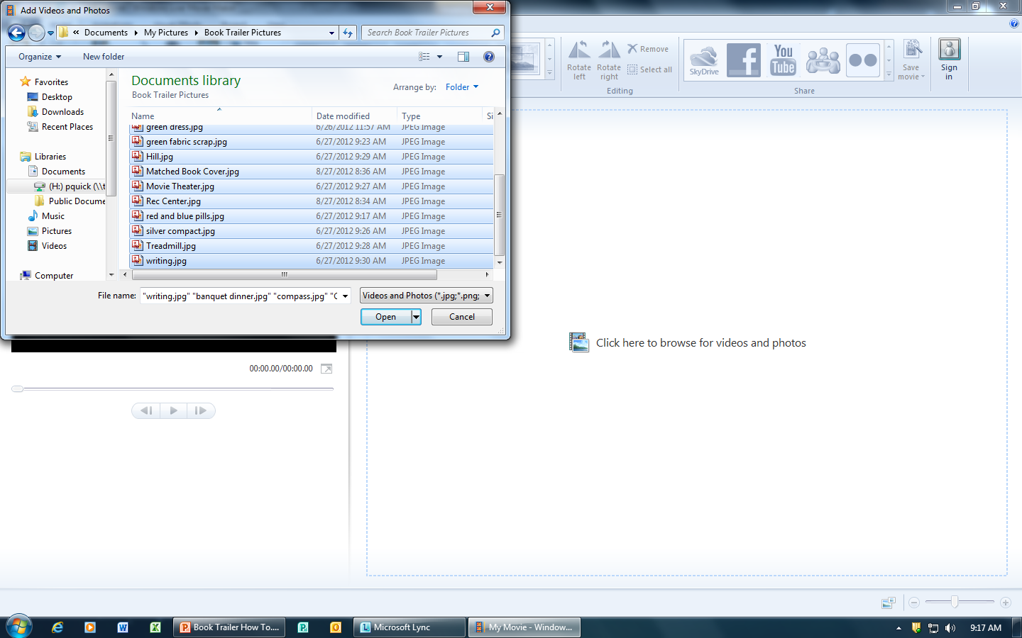
Select all of the pictures in your folder by doing the following: “Highlight” the first one by clicking on it Hold down the “shift” key while you press “Enter”
Once you have selected all of your pictures click “Open”

Slide 7
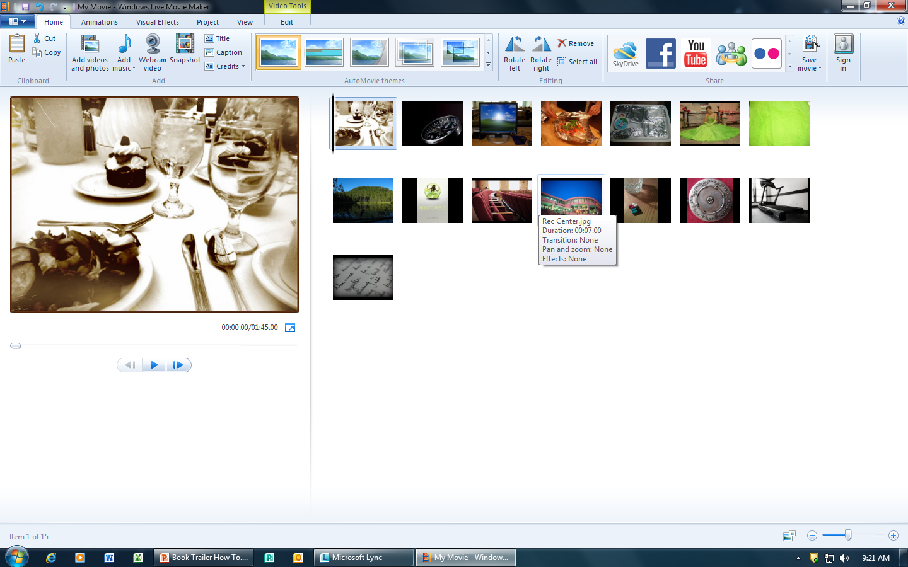
Your pictures should now be “loaded” into the Movie Maker Program

Slide 8
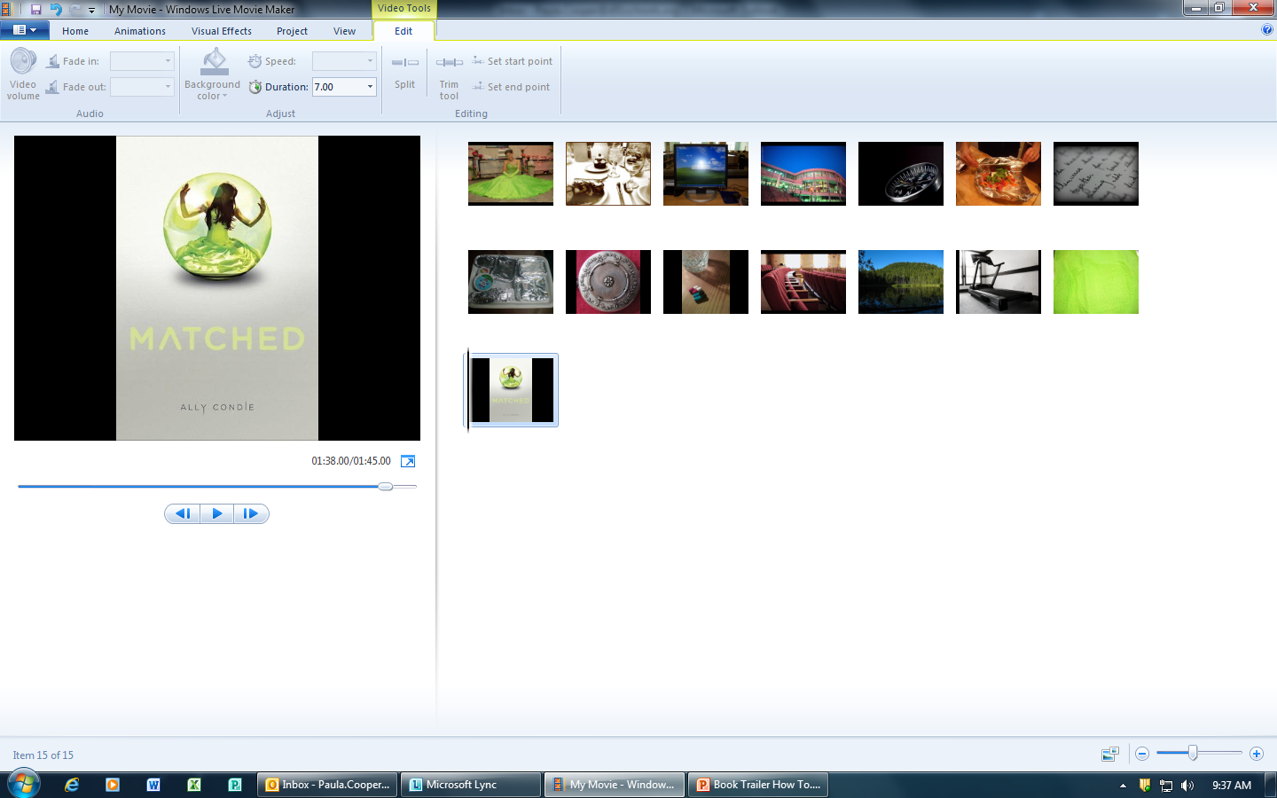
You may change the order of your pictures by clicking on a picture, holding the mouse down and “dragging” it to where you want it

Slide 9
Adding Text

Slide 10
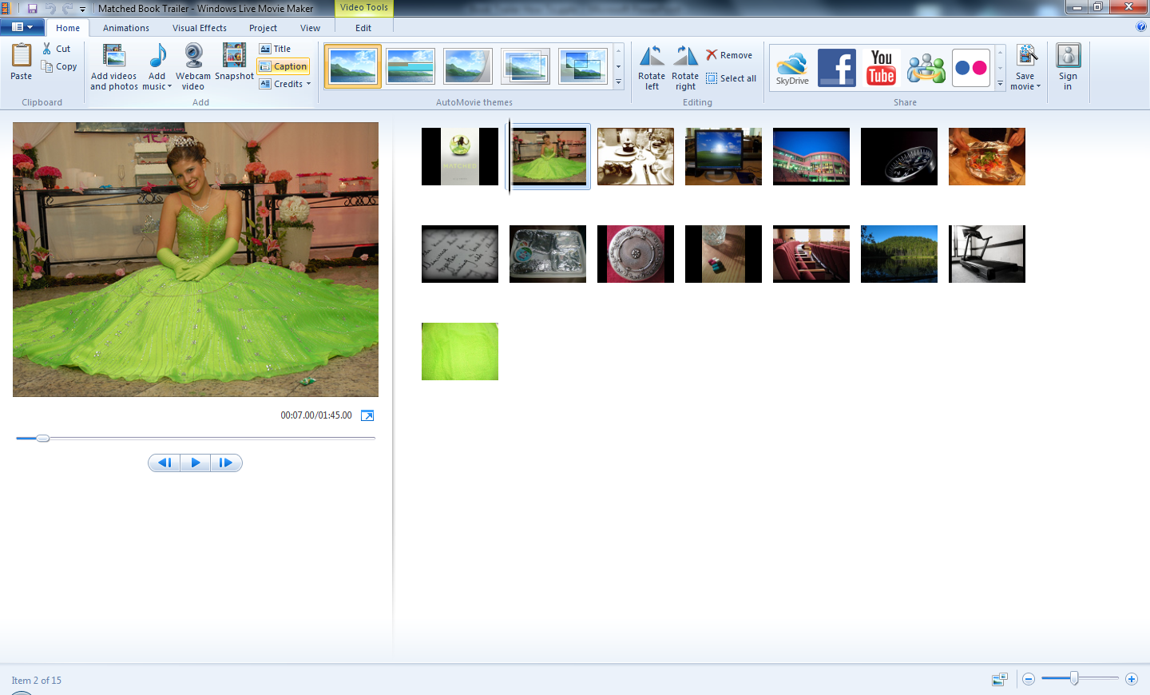
Highlight the frame you want to add text to. Click on the “Caption” button (Found under the home tab)

Slide 11
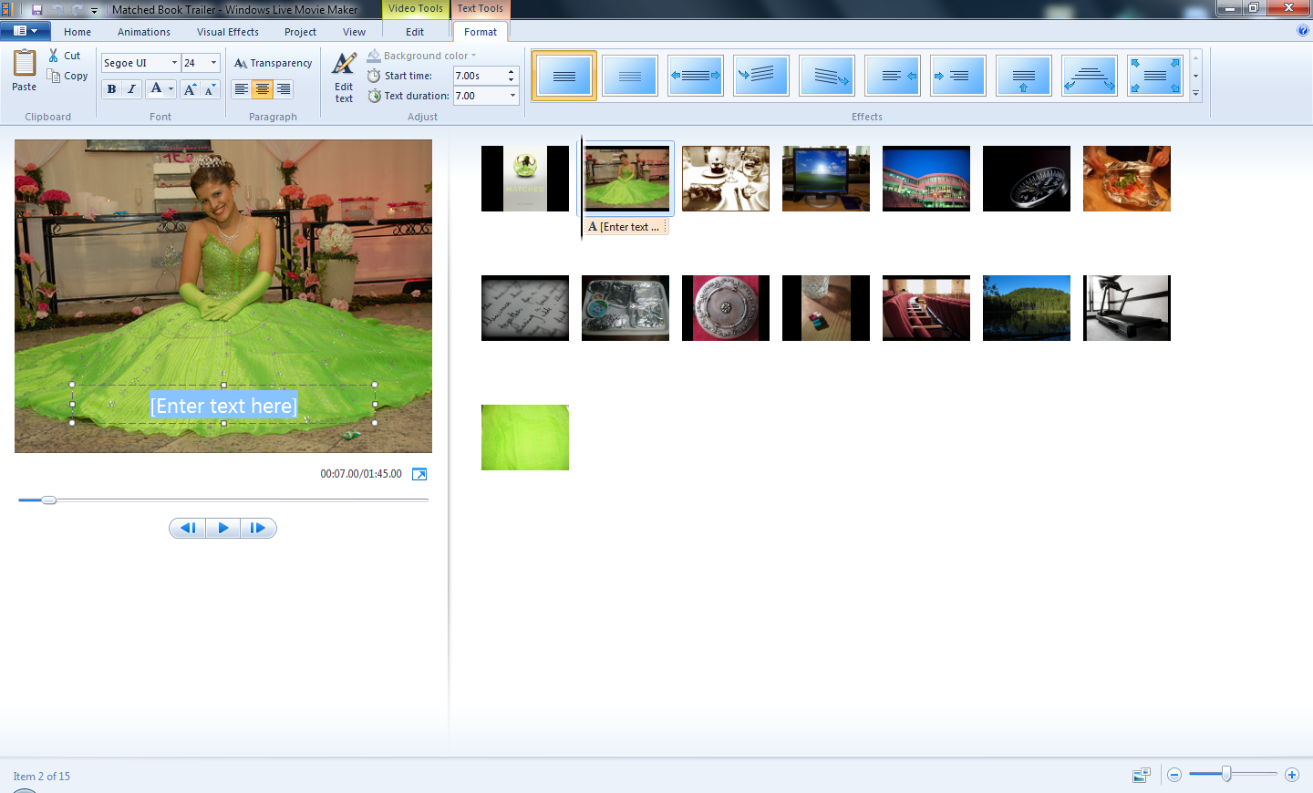
You should now see a text box. Type you text in this box. You may format it to the font, size and color you choose as long as it is “readable”.

